Slide 1
Homework Assignment 5
Digital Image Processing
Deadline: 09:00 AM, Monday, 12/9/2024

Slide 2


Problem 1 (50%)
Refer to the image and the disk structuring element shown in the lower right of the image. Sketch what the sets C, D, E, and F would look like for the following sequence of operations: C = A  B; D = C B; E = D B; and F = EB. Set A consists of all the foreground pixels (white), except the structuring element, B, which you may assume is just large enough to encompass any of the random elements in the image. Note that the sequence of operations above is simply the opening of A by B followed by a closing of the result by B.
$$⊕$$
$$⊕$$

Slide 3
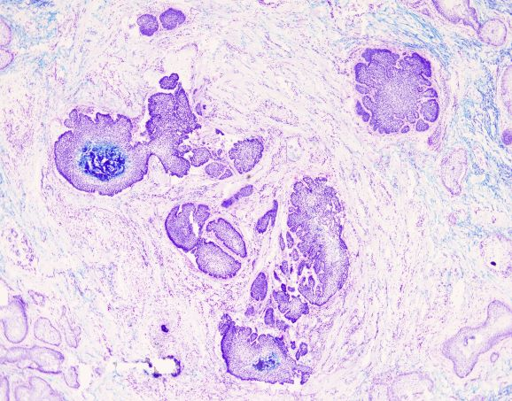
Problem 2 (50%)
Color is a useful piece of information for image segmentation. In this homework, you are asked to color information to segment the basal cell carcinomas (the purple areas) from a skin tissue image. You are encouraged to apply the techniques in Chapters 6 and 10 to solve the problem.

Slide 4
Software Package Allowed
Python 3.8+
Standard Python library
Numpy 1.21.1
Opencv-python 4.5.1
Matplotlib 3.6.0

Slide 5
Assignment Requirements
All functions in the Software Package are allowed.
Set your directory structure as follows:
r119XXXXX/
- p1.py
- p2.py
- report.pdf
- images/
- FigP0917(noisy_rectangle).tif, image2.jpg
- Images of program output

Slide 6
Assignment Submission Requirements
Submit to NTU COOL
Do NOT copy homework (code, report, results, etc.) from others

